Slide 1
Classification of Recipe Cuisines using Recipe Ingredients
Erik Enriquez
Mentor: Alex Rutherford

Slide 2
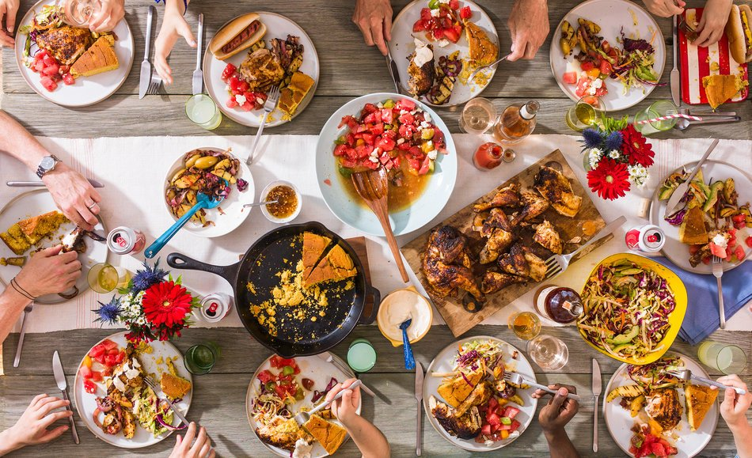
Purpose
Objectives
With this dataset, provided by Yummly, I aim to answer the following questions:
What are the ingredients uniquely used or combined that make up the “signatures” of particular cuisines?
Can we learn more about the origins of cuisine by analyzing their ingredients to provide insights into the cultures and regions from which they originate?

Slide 3
Data Acquisition
This dataset was acquired on a Kaggle competition site, provided by Yummly.
The data was in JSON format initially and processed into a dataframe
The data included only 3 columns (Recipe ID, Cuisine, and Ingredients) and ~40,000 entries
20 Cuisine categories were present in the data, with almost 8,000 unique ingredients

Slide 4
Data Cleaning/Preprocessing
Although there were no missing/duplicate entries in the data, the preprocessing was quite demanding. The following techniques were performed to decrease the number of ingredient from almost 8,000 to ~730:
Nouns were extracted from all ingredients (no adjectives, verbs etc.)
Misspellings were identified and corrected, brand-related words were removed
Singular forms were taken for all ingredients (e.g. eggs = egg)
--- After this, about 4,000 ingredients remained
4. Ingredients that appeared in the dataset less than 40 times (< 0.1% of entries) were removed
--- After this, ~730 ingredients remained

Slide 5
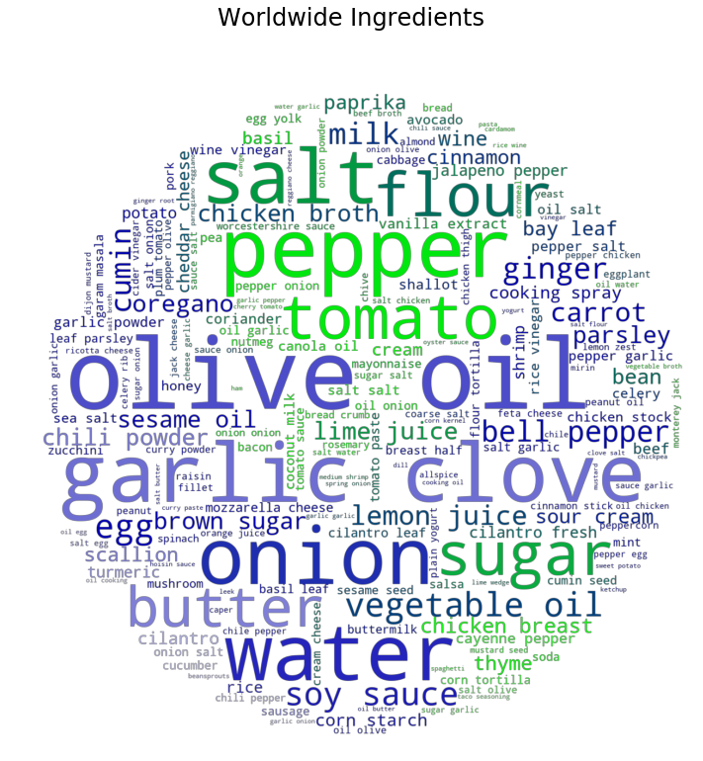
Exploratory Analysis
First a Bag-of-Words model was employed to find most common ingredients:
Worldwide
For each cuisine

Slide 6
Exploratory Analysis
It was found that ingredients like Salt, Onion, Flour, etc. were ubiquitous and seemed to dominate all cuisines
TF-IDF processing was employed to find the ingredients that really formed the signature flavors of each cuisine
Results were visualized by both bar charts of TF-IDF weightings vs. cuisine as well as word cloud graphics

Slide 7
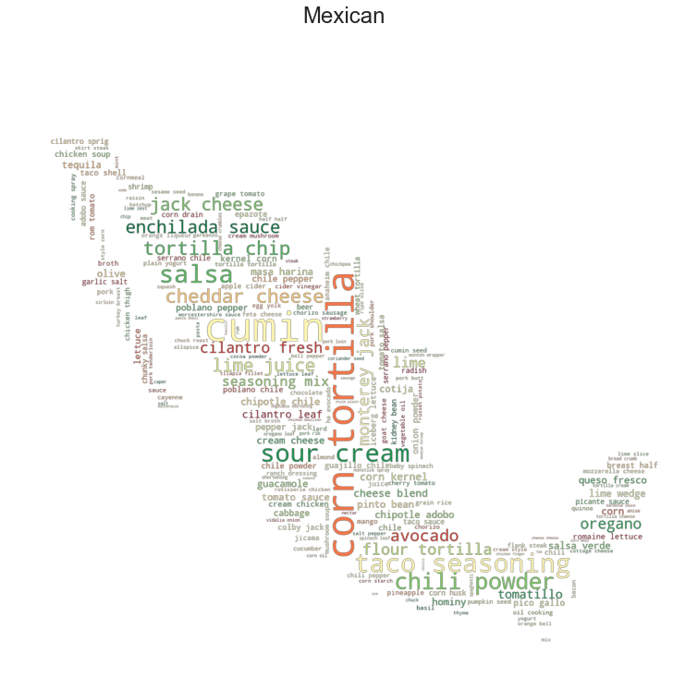
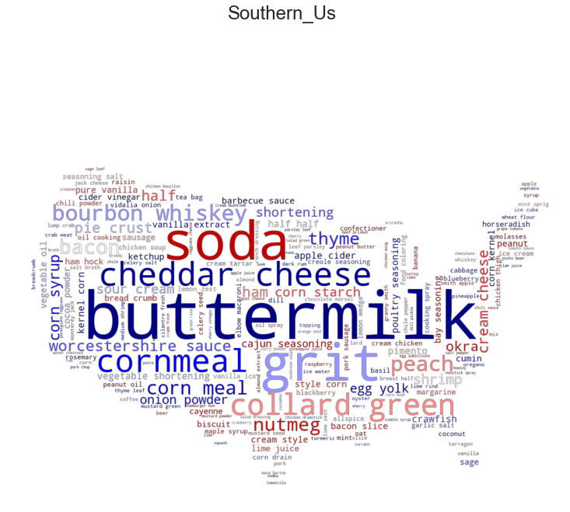

Slide 8
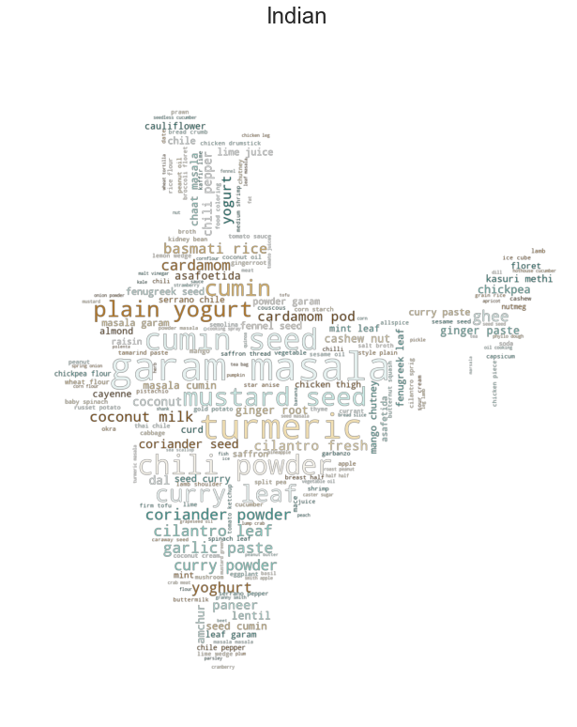
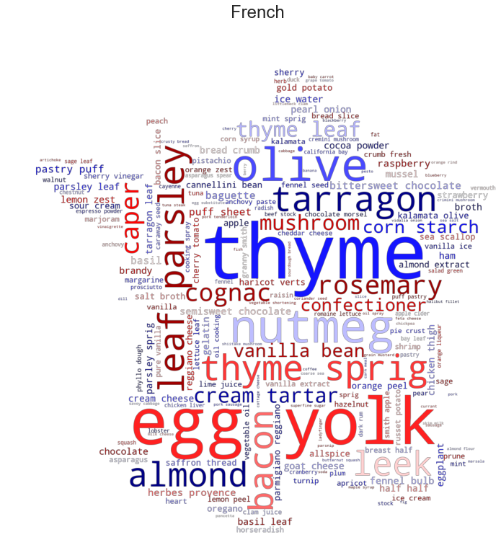

Slide 9
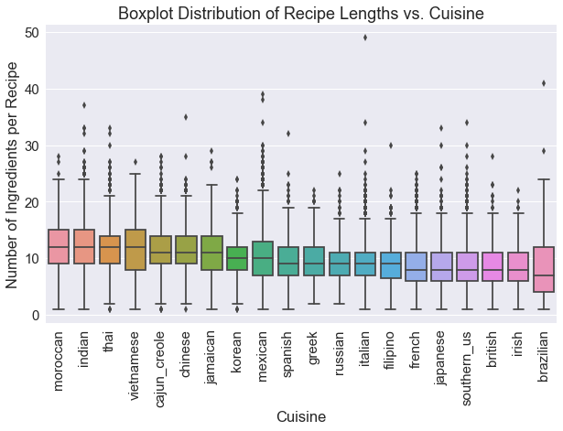
Exploratory Analysis
Cuisines were also broken down by recipe to analyze details of the distribution of length and ingredient varieties for each cuisine

Slide 10
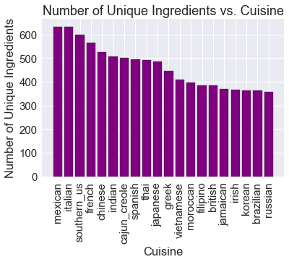
Exploratory Analysis

Slide 11
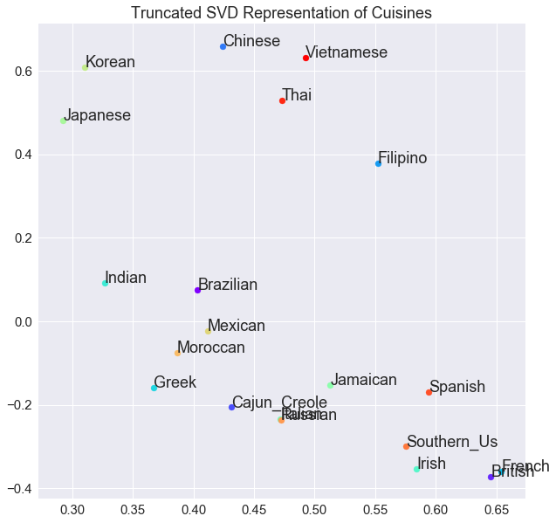
Exploratory Analysis
When all recipes were aggregated into their respective cuisines, patterns emerged suggesting that cuisine similarities were partly dependent on geography

Slide 12
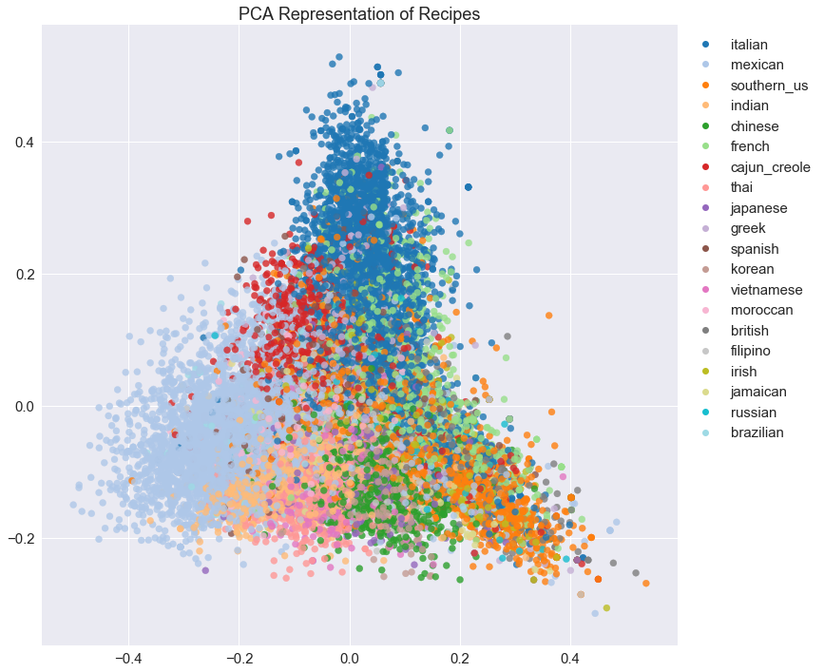
Exploratory Analysis
Also, when each recipe was considered individually, similar patterns still emerged

Slide 13
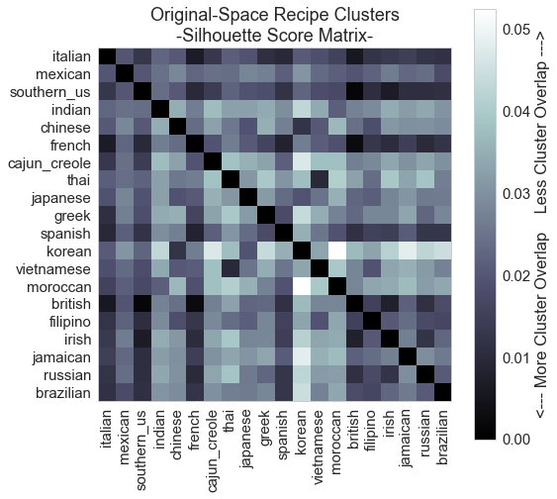
Exploratory Analysis (Cluster Analysis)

Slide 14
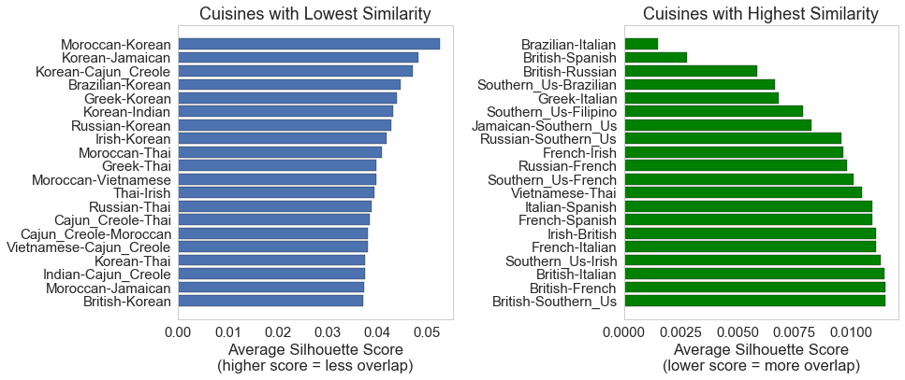
Exploratory Analysis (Cluster Analysis)

Slide 15
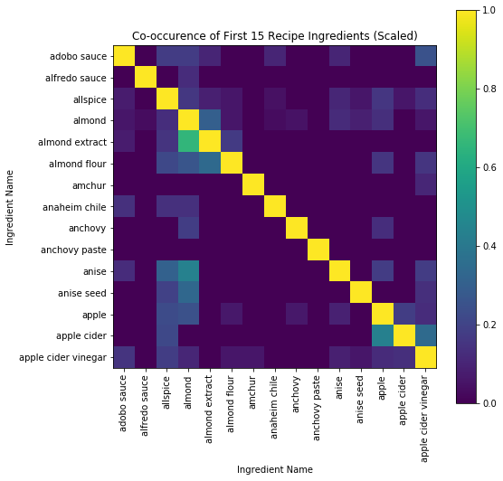
Exploratory Analysis
Finally, ingredients themselves were analyzed by studying their co-occurrence with each other ingredient in the data

Slide 16
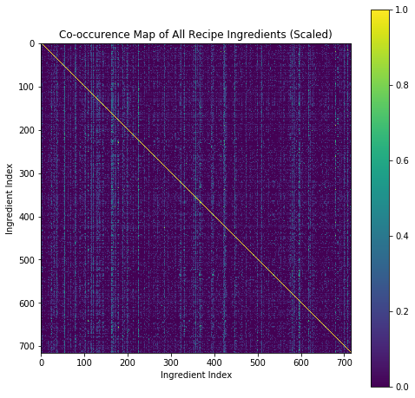
Exploratory Analysis
Full ingredient co-occurrence matrix

Slide 17
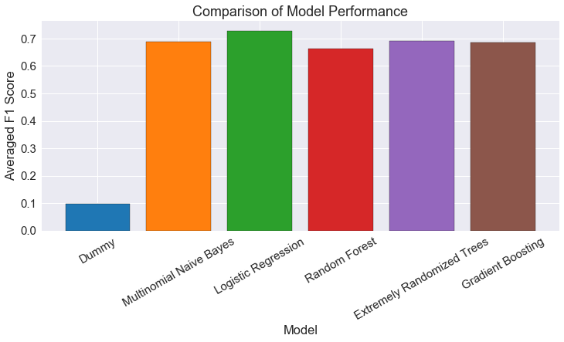
Classification Models
Several models were considered and compared for classification of the data

Slide 18
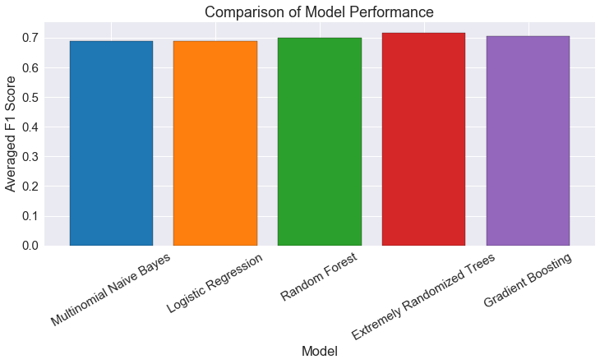
Classification Models
Using average F1 score as the main metric, the following optimizations were performed:
Class weighting (for imbalanced distribution)
Number of estimators (trade-off between speed and accuracy)

Slide 19
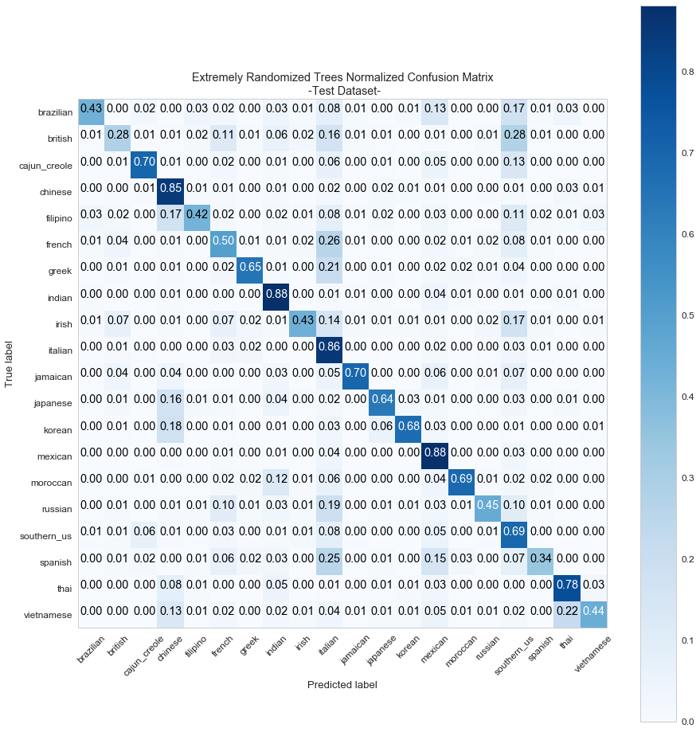
Classification Models
Confusion matrix can help to evaluate optimized model performance

Slide 20
Recommendation Engines
The following recommendation engines were built by leveraging the TF-IDF of processed data and analysis results:
Simple recommendation engine - recommend the most similar recipes to a user's current recipe
Recipe discovery engine - recommend the most similar recipes to a user's current recipe that are from different cuisines unique from the user's original recipe cuisine. Example: (User's recipe is Italian) "Here are 3 similar recipes from French, Irish, and Spanish cuisines.”
Ingredient list-based recipe recommendation engine - take the ingredients that a user has, and recommend recipes that can be made, along with suggestions for which additional ingredients they may need.
Ingredient pairing recommendation engine - take ingredients for a user's recipe and recommend ingredients that are likely to pair well based on how often they are used together in the dataset.

Slide 21
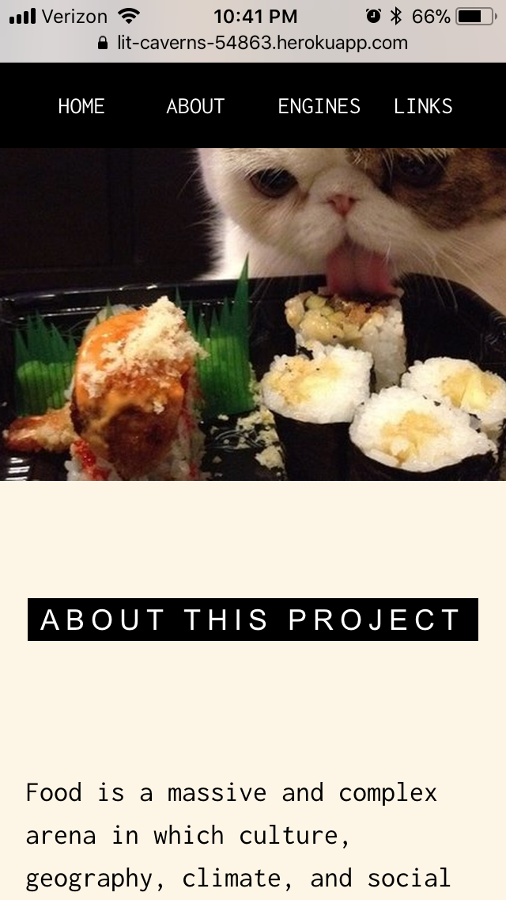
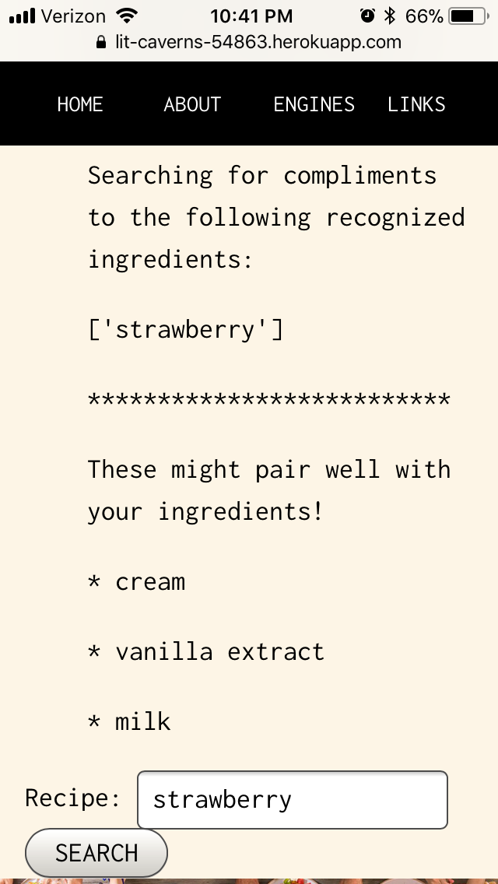
Live Web App
Live web app leverages the TF-IDF features and analysis insights for several functions of recipe and ingredient recommendations for users!

Slide 22
Conclusions
NLP techniques were carried out to perform analysis and classification models on recipe ingredients/cuisine category dataset
The analysis showed groupings on several levels indicating that cuisines share many qualities dependent on their geographic locations of countries of origin
Recommendation Engines were built and deployed on live sites to leverage analysis results to provide functional insights to the public with this data

Slide 23
Thank you!
Thanks to Springboard team for providing curriculum and continued support
Special thanks to Alex Rutherford for guidance and mentorship on this project

Slide 24
Additional Resources
Yummly – Website
Dataset – kaggle
Project Proposal – github link
Code (IPython Notebooks):
Data Cleaning – github link
Data Exploration - github link
Classification Models – github link
Recommendation Engines – github link
Heroku/Flask Web App for Recommendation Engines - Website

